Slide 1
CCA Marlins Volunteer and Team Family Engagement

Slide 2
2025-2026 Volunteer Requirements
Each Family is required to volunteer for 6 sessions.
This can be anyone in the family or a friend for the family.
Sign-ups for opportunities will appear with the meet sign-up on teamunify
Volunteering will be tracked and will result in a $200 fine at the end of the season
Pre-meet training and exposure can be arranged, so you have an idea before you arrive.
Committee volunteering can count toward sessions

Slide 3
Volunteer Roles
Meet Specific Needs:
Announcer
Clerk of Course
Head Timer
Hospitality
Runner
Set Up/Clean Up
***Timers***
Marshal / Official (requires additional training)
Non- Meet Specific Needs:
Committee Member – The team has three committees, each overseen by a board member and a coach.
Committees include:
Swim Meet Committee
Hospitality Committee
Fundraising Committee

Slide 4

Role Descriptions
Announcer – The announcer uses a microphone to announce each event in the pool area, make general announcements, and at Championship meets, announce lists of finalists.
Clerk of Course – Volunteers manage the area at the meet where young swimmers report before their event. Volunteers help announce upcoming events in the team seating area, arrange swimmers into their heat and lane assignments, and escort arranged swimmers to the blocks.
Head Timer – A volunteer that stands near the starter and starts two stopwatches at the beginning of each race. They will watch for lane timers to signal a watch malfunction by raising their hand.
Hospitality – Volunteers help feed the coaches and officials at a team-hosted swim meet and sometimes sell food to swimmers and spectators. Helping with hospitality can also include donating food, drinks, and paper goods before a swim meet.
Runner – A volunteer that gathers timer sheets and DQ slips and takes them to the Administrative Officials or Referee at a swim meet.
Set Up/Clean Up – A volunteer that helps prepare the pool for a swim meet (set up) or return the pool area to normal after a swim meet (clean up). Set up usually includes a few hours before the meet starts and a few hours a day or two before the meet. Clean up occurs directly after the end of the meet.
Timer – A volunteer that operates a stopwatch to provide an accurate time for every swim. Timers also make sure the right swimmer is in the right event, heat, and lane.
** We need a lot of timers every meet**

Slide 5

Role Descriptions
Official – Trained volunteers that ensure consistency in all the rules of USA Swimming at swim meets. Types of officials include Referees, Starters, Stroke & Turn Officials, and Administrative Officials. Officials are the volunteers around the pool during swim meets with white shirts on. Please email our head stroke and turn judge Juliet Vile at jdvile@gmail.com if you are interested in being an official.
Marshal/ Meet Safety Officer – A volunteer whose responsibility is to enforce warm-up procedures and maintain order in the swimming venue. Safety in the swimming venue is their priority. The team needs 10 volunteers to be certified as Marshals. Training is available on the USA Swimming website VSI Meet Marshal Training Guide. Parents can access the Meet Marshal Exam through the Education Course Catalog tab in their accounts on www.usaswimming.org. Click on the browse button to see all of the available training and certifications and scroll thru to find the Meet Marshal Exam.

Slide 6

Hospitality Committee
Board Contact: Whitney Smith
Coach Sponsor: Coach Susan
This committee is the spread warmth and comfort coalition. Some common task include but not limited to:
URGENT NEED- “Travel Agent”- Person to plan team hotels
Meal planning for meets ( budgeting, coordination, set-up)
Parties, banquets, and award ceremonies
If we want to bring some of these back, we need people!
Pool potlucks, parties, banquets, award ceremonies, gold gathering, Saturday Senior Breakfast.
If you are interested in supporting, please reach out to Whitney @ Whitnesmith@gmail.com or indicate your interest on the parent interest survey to follow.

Slide 7

Fundraising Committee
Board Contact: Julie Miller
Coach Sponsor: Coach Buffy
This committee are the bridge builders and assist with all things financial. Some common task include but not limited to:
Championing local involvement
Generating financial sponsorships
Helping with fundraising opportunities- AmazonSmiles, Kroger, Concessions, Swag, Swim-a-Thon, and more
Relationship creation and maintaining
Grant writing if we have a person and opportunity **
If you are interested in supporting, please reach out to Julie @ jeh4306@gmail.com or indicate your interest on the parent interest survey to follow.

Slide 8

Meet Committee
Board Contact: Juliet
Coach Sponsor: Amina
This committee are those who get us swimming and keep us swimming. Some common task include but not limited to:
Read/Analyze Times and data
Selecting and Coordination of:
Meet Vendors, locations, business agreements, paperwork
Getting officials for the team
Meet safety coordination
Creating Psych Sheets/ Heat Sheets
If you are interested in supporting, please reach out to Juliet @ jdvile@gmail.com or indicate your interest on the parent interest survey to follow.

Slide 9
Team Engagement
Opportunities to connect and grow- outside of the water.

Slide 10
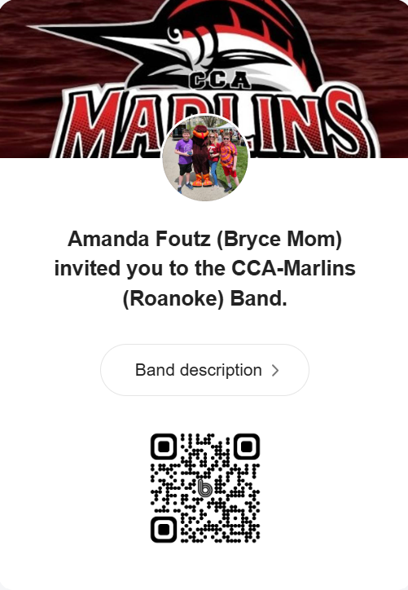
New Team Swim App
We are going to start a communication portal on the Band App.
CCA Marlins Band Site

Slide 11
Team Engagement Activities
Social activities as a team to help team bond and give back.
These are all optional, not extra, but studies have shown that teams with external non-practice team events are more likely to:
Build cohesion and belonging.
Support social-emotional growth.
Strengthen community connection.
Boost enjoyment and retention.
Foster life skills and character.
Monthly engagement activities will provide opportunities for all swim groups to interact and support a singular cause/mission for that month.
Notes:
Reason Representative Reference(s) 1. Team cohesion & belonging Bruner et al. (2014); Applied Sport Psychology; Wikipedia 2. Social-emotional development Kahn (2019), SBYD models 3. Community connection Sherlock (2024); Project Play (Aspen Institute) 4. Retention & enjoyment Project Play data; Verywell Mind 5. Character & life skills Positive Youth Development (Wikipedia); Project Play

Slide 12
Team Engagement Activities
Calendar of Events
Month | Event Date | Team Event | Service/ Give Back
September 2025 | TBD | Summer Send-Off & Suit Pass-Down —gear/uniform trade, | Diaper Drive
October 2025 | TBD | Spooky Splash Swim-A-Thon — glow stick relays, pumpkin push races, costume-cap decorating | Marlins Fundraiser
November 2025 | Thursday, Nov 27 | Drumstick Dash – “gather as a team to move our feet so others can eat” | Food pantry donations for SWVA 2Nd Harvest Food Pantry
December 2025 | TBD | Illumilights or Ugly Sweater Caroling | Adopt-a-Senior(s)
January 2026 | Saturday, Jan 10 | Pool Movie Night & Pizza — projector, swim-themed film | Coat/Sock/Blanket drive to support The Least of These
February 2026 | Saturday, Feb 14 | Buddy Swim Valentine Relays — older/younger pairings, valentine exchange Possible Parent night out- to support Senior Training Trip- more to follow | Valentine Exchange – Public Service Thank You- To support Local Public service
Information will be added on Band soon!!!
If you have a recommendation please let us know.
Notes:
Reason Representative Reference(s) 1. Team cohesion & belonging Bruner et al. (2014); Applied Sport Psychology; Wikipedia 2. Social-emotional development Kahn (2019), SBYD models 3. Community connection Sherlock (2024); Project Play (Aspen Institute) 4. Retention & enjoyment Project Play data; Verywell Mind 5. Character & life skills Positive Youth Development (Wikipedia); Project Play
Diaper drive sept.
Swim A Thon-

Slide 13
Parent Collaboration
Donuts on The Deck- Parent Chat
How do I do that timing thing next weekend?
What stroke is it that looks like a water strider?
What are snacks that are meet/pool deck smart?
Why the heck has this been the craziest week of the year? (Doesn’t have to be swim talk- life is a lot sometimes)
Sat, Sept 27
Sat, Oct 25
Sat, Nov 15
Sat, Dec 20
Sat, Jan 24
Sat, Feb 21
Sat, Mar 14
Sat, Apr 25
Team App-Parent Engagement
Opportunity to connect with other Marlin families during meets
Connect for carpool, gear swap, tips, and tricks
Notes:
Reason Representative Reference(s) 1. Team cohesion & belonging Bruner et al. (2014); Applied Sport Psychology; Wikipedia 2. Social-emotional development Kahn (2019), SBYD models 3. Community connection Sherlock (2024); Project Play (Aspen Institute) 4. Retention & enjoyment Project Play data; Verywell Mind 5. Character & life skills Positive Youth Development (Wikipedia); Project Play

Slide 14
Thank you!
Please complete the survey to follow.

